Slide 1
The Pencil of the Future
Kostylev Vladislav Voronin Matvey
Kagramanian Artemy
B01-208, MIPT 2023

Slide 2
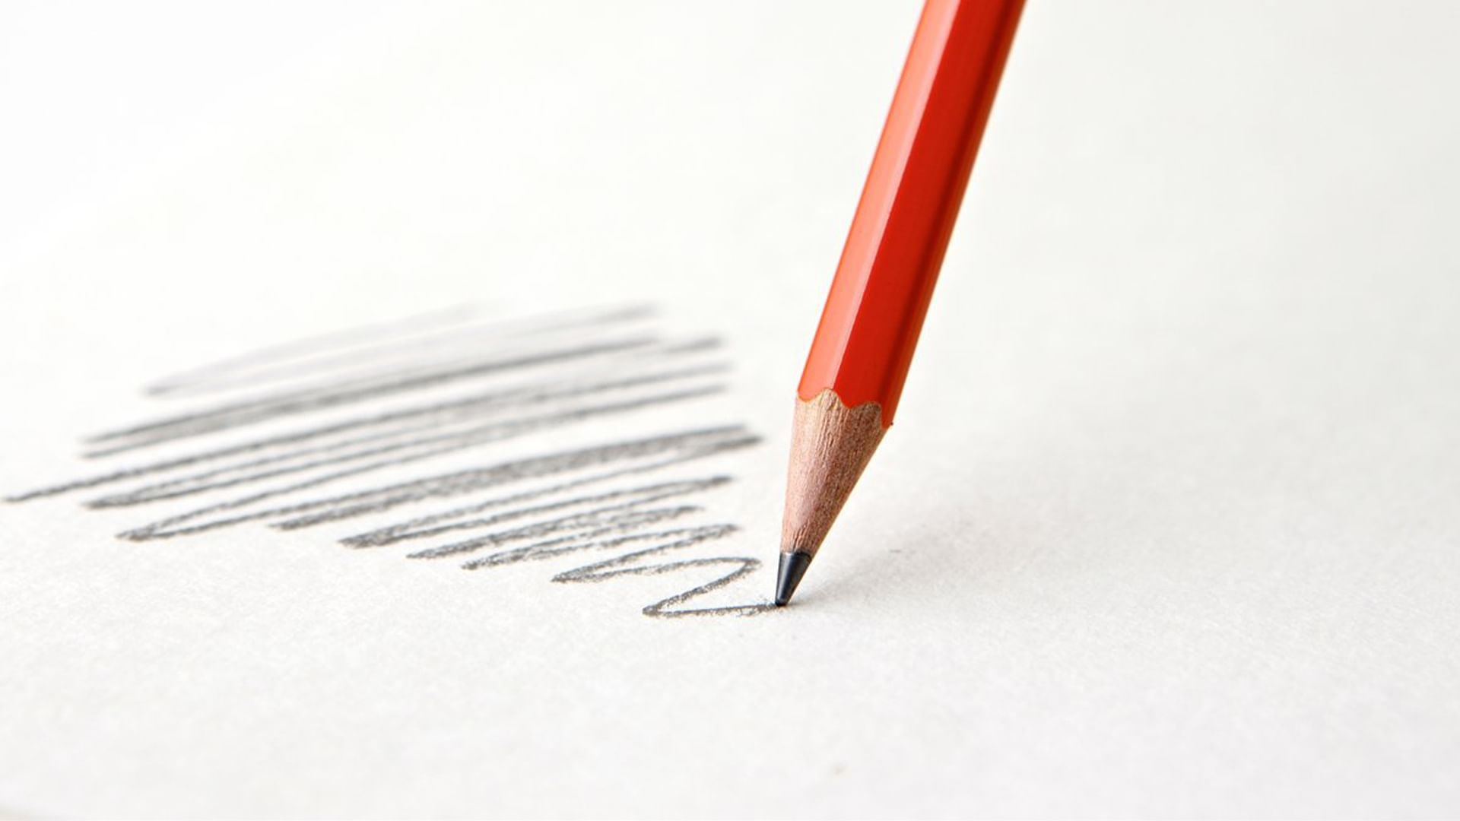
About Us

Slide 3
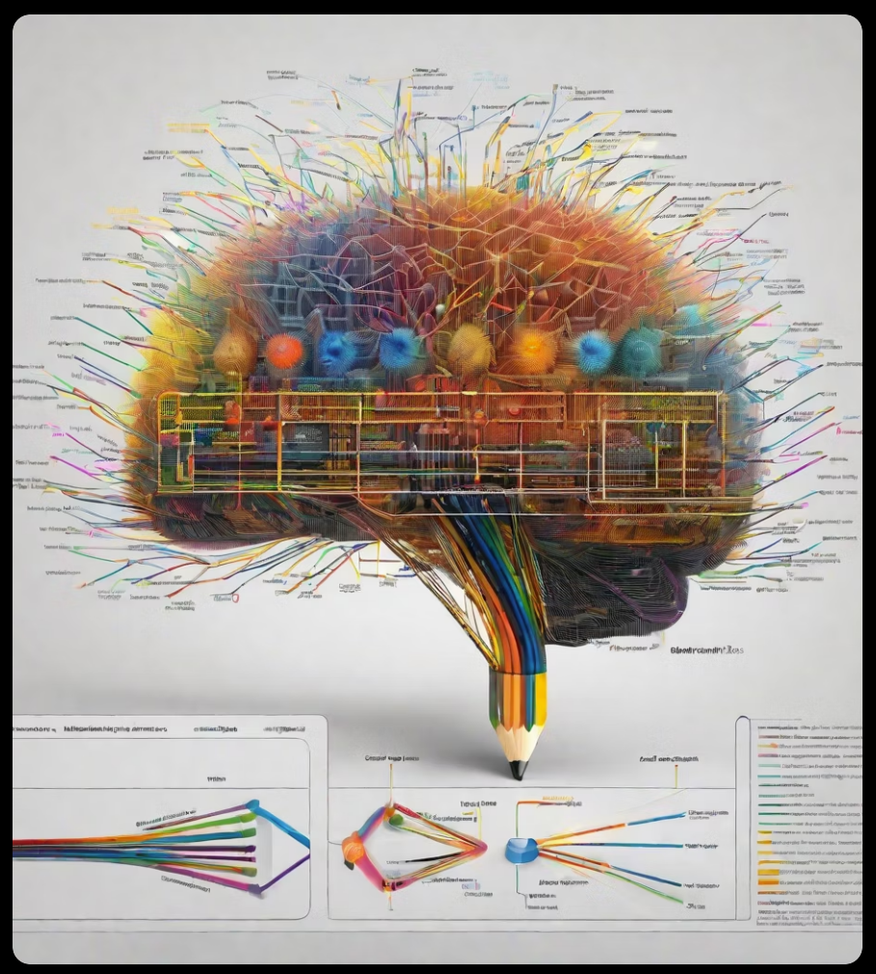
Built-in Neural
Network

Slide 4
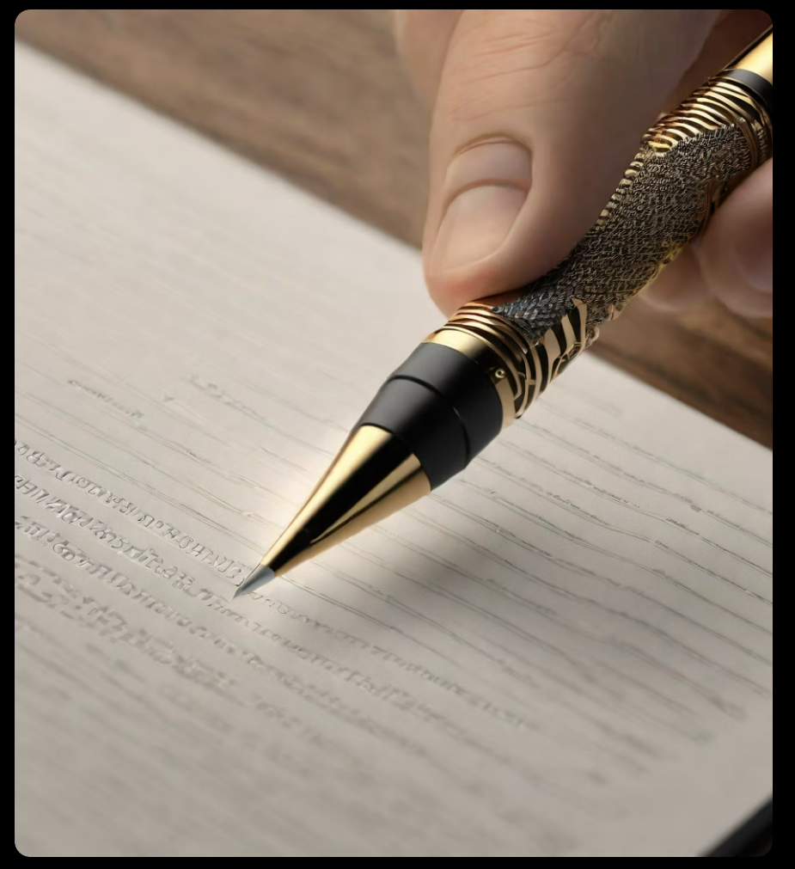
Handwriting Memory Function

Slide 5
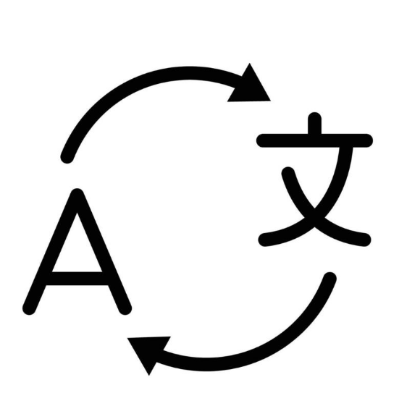
Translator

Slide 6
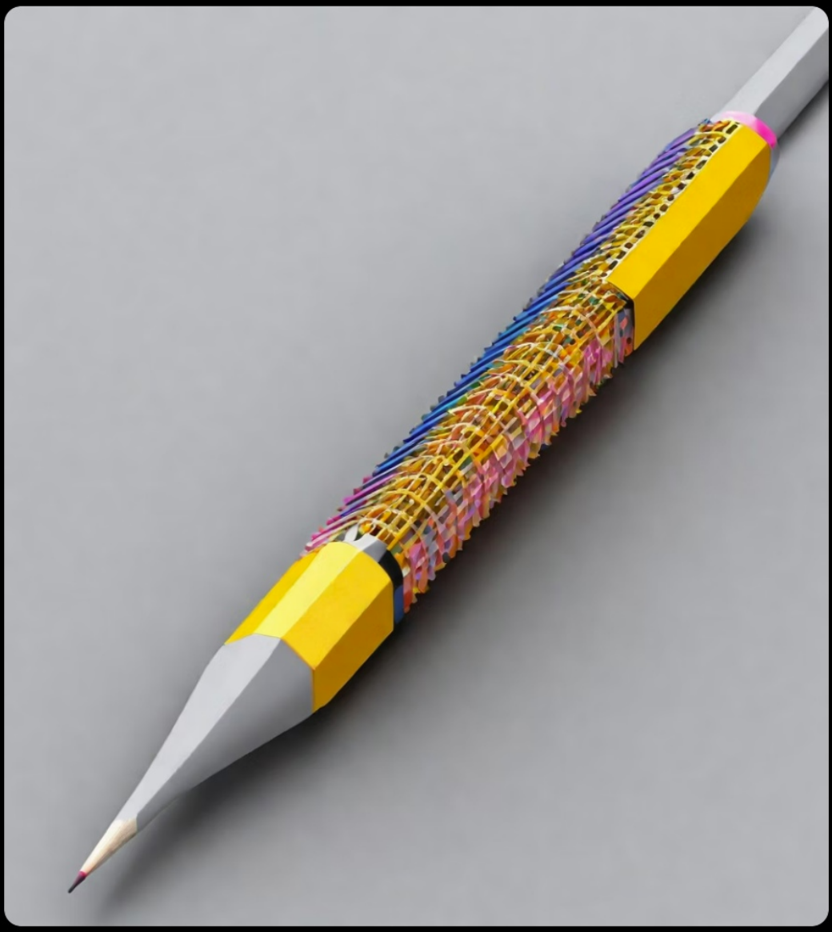
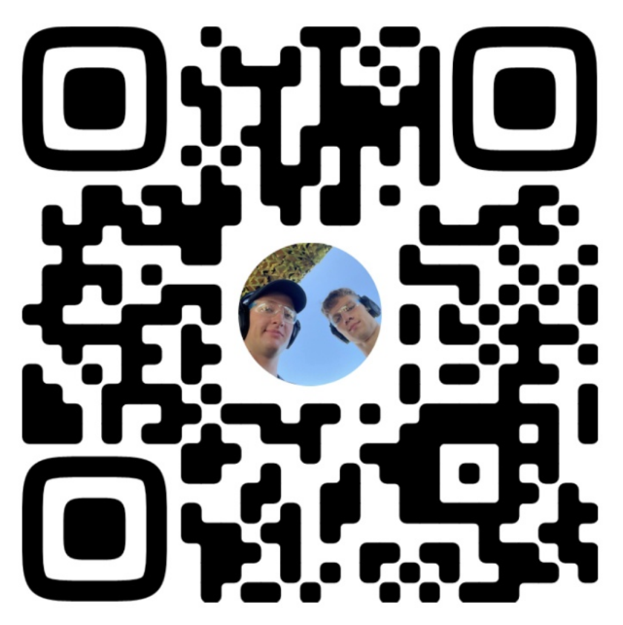
KVK Pensil
500$

Slide 7
Thank You!

